Slide 1
Initial Expedition Training Learning Outcome 1 Weather
Uncontrolled copy not subject to amendment
Version 2.0 OCT 2014

Slide 2
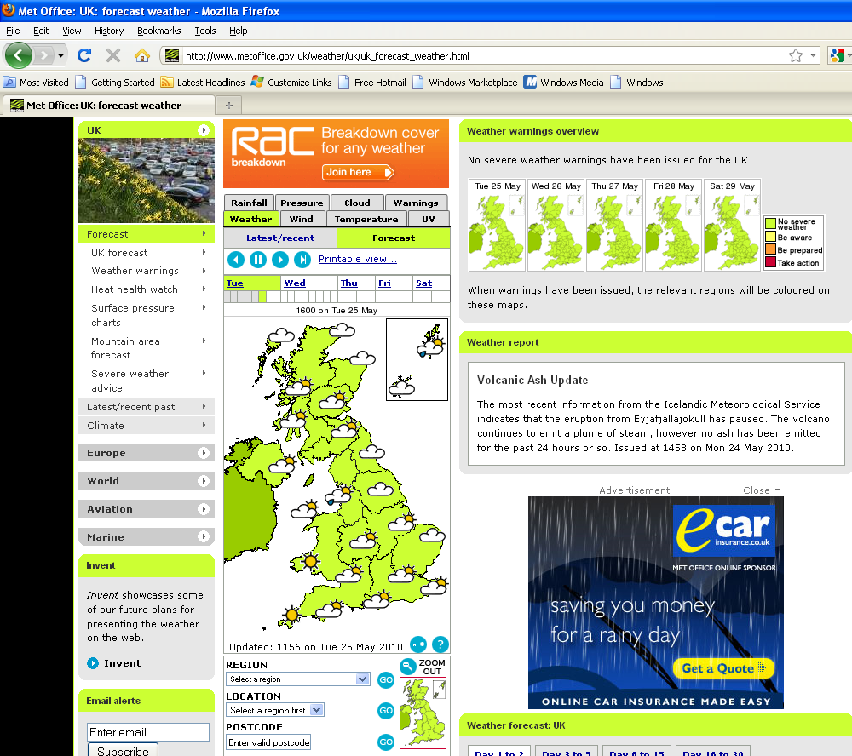
The British Weather
Snow is lying on the ground; and in the air the sleigh-bells sound; the frosted patterned window panes; it’s British Summer Time again!
Notes:
Britain is a very weather intense place to be. However, forecasts are (probably as a result of the weather) easily available. Go to the source – the met office. www.metoffice.gov.uk – note the easy availability of weather, temp, wind forecasts. Specialist mountain area forecasts are available as is raw data. There is little or no excuse for not being equipped and prepared for forecast weather.

Slide 3
Reading the weather data
Weather
Wind
Temperature
UV Index
Notes:
3

Slide 4
Sunshine
UV Index
Exposure category | Low | Moderate | High | Very high | Extreme
Protection required | None. You can safely stay outside. | Seek shade during midday hours, cover up and wear sunscreen. |  | Avoid being outside during midday hours. Shirt, sunscreen and hat essential.
Even with dark skin, damage can be caused by the sun. Sun protection factors of over 30 and preferably 50+ are best for expeditions. You could be in the sun for up to 12 hours.
Notes:
Symbols are used by www.metoffice.go.uk
4

Slide 5
Heat
Look at the weather forecast – this picture was taken at 28º C. This group of cadets needed nearly 4 litres of water each that day.
Notes:
5

Slide 6
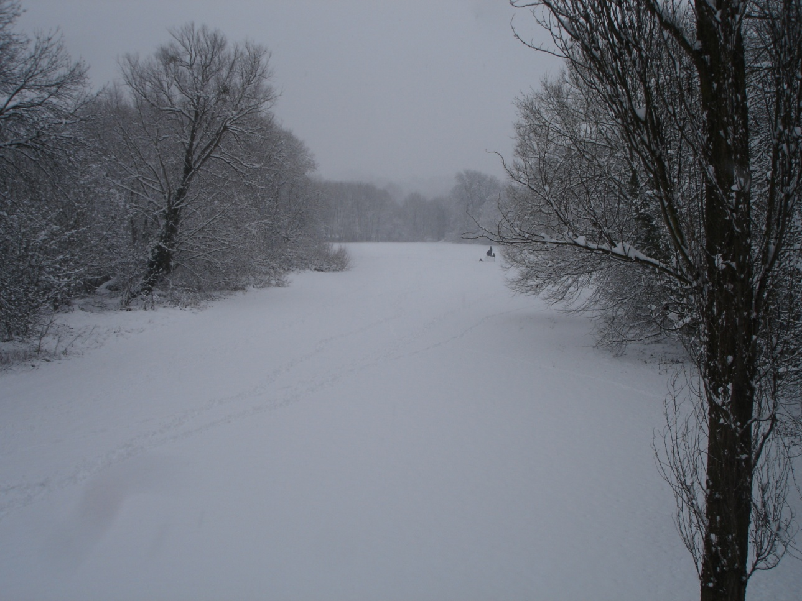
Snow and ice
Think about – slips and falls; cold and wet; navigation
Notes:
Snow and ice are beyond the qualifications for BELA, WGL and ML(S). You will not be covered by Air Cadet approval and therefore insurance.
Snow and ice make it very easy to fall over and it’s not always a soft landing. It can very VERY cold and in any wind temperatures can drop to minus 10 even in tame countryside. Hands, feet and faces get bitterly cold and even a 3-season sleeping bag will not be enough. Few cadets are equipped to work well and enjoy these conditions in an expedition context. A 1 h snowball fight is one thing; a 2-day trek another. Especially in wild country, snow can cover the ground making navigation much more challenging.
6

Slide 7
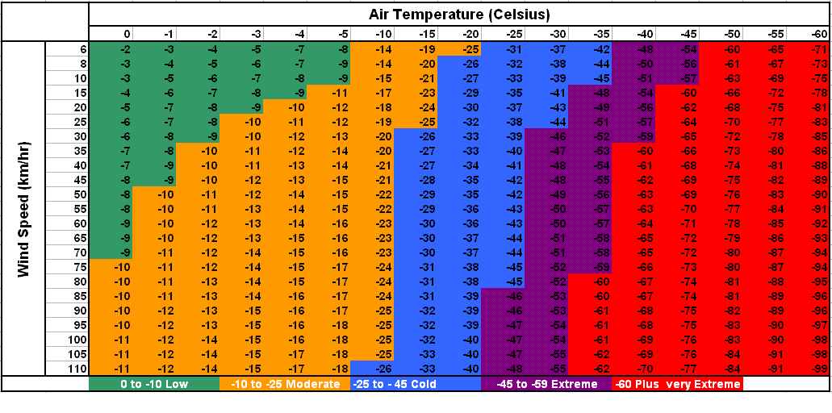
Wind
The stronger the wind the colder it will feel. Note that even fairly gentle wind lowers the temp by 3 or 4º C
Notes:
Note- The wind chill does not keep getting bigger, but 35 mph drops the effective temp by 7 C. This is for dry clothing! The effects will be much worse if you’re wet. The colour codes relate to chance of frostbite.
7

Slide 8
Mountain area forecasts
Mountain areas
Notes:
Note that the metoffice provides a link to symbols. Essentially coloured lines and thick black lines mean clouds and rain are possible. Isobars mean wind. The strength of the wind is likely to be roughly equal to 10 x number of lines crossing Britain. This course is not a substitute for a proper met course. The aim is not to get the cadets up to detailed weather forecasting. But, they should know where to go and how to start. Set them a weather diary for the week. Or, just make sure you put the forecast up for every squadron trip and talk them through it.
8

Slide 9
Drawing your own conclusions
Surface pressure
Notes:
9

